Slide 1

Emerald Ash Borers in Ontario
Eva Grigorovsky , Jem Barrett, Jessica Underwood, Santhija Jegatheeswaran

Slide 2
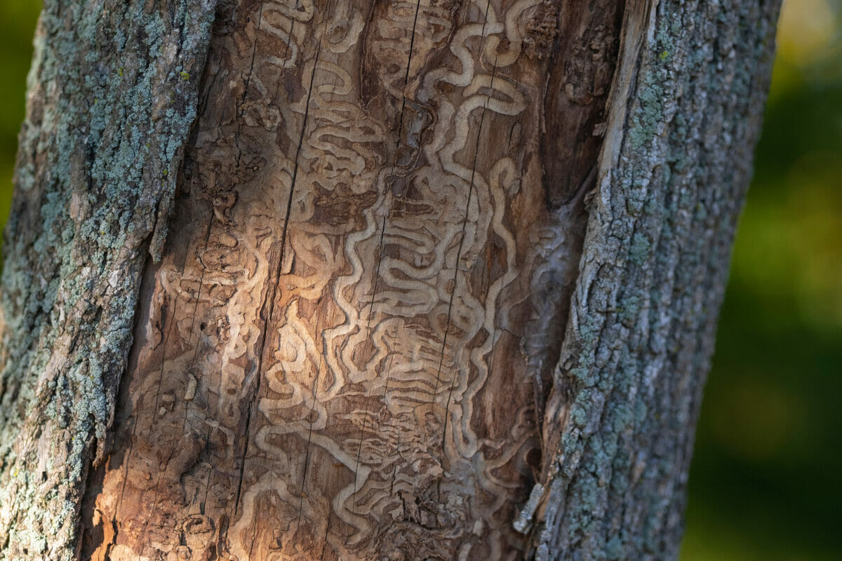
Background
Emerald Ash Borer (EAB)
Invasive wood-boring beetle species¹
Accidentally introduced into North America 2002
Detected near Windsor, Ontario
Tunnel in ash trees
2-4 years of EAB larval presence leads to tree mortality¹
WHY SHOULD WE CARE?
All NA ash trees are susceptible to EAB
Widespread across southern Ontario and has killed 90% of ash trees since first appeared²
Research Question:
How is the detection of EAB populations changing across Ontario communities?
Notes:
The emerald ash borer (Agrilus planipennis) is an invasive wood-boring beetle species that originated from northeastern Asia and is now found across North America (Johny et al., 2012).
EAB disrupts the flow of water and nutrients in the phloem of its primary target, ash trees (Fraxinus spp.), when their larvae eat tunnels into the inner bark. It takes around 2-3 years for this to kill the tree, during which the EAB will continue to breed and spread (Johny et al., 2012).
Canada
EAB was initially detected in 2002 near Windsor, Ontario, and since then, it has spread across Ontario, Southern Quebec, Winnipeg, Manitoba, New Brunswick, and Nova Scotia (Butler et al., 2022).

Slide 3

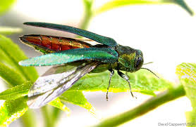
Hypotheses
#1: Time impacts the detection of EABs in various Ontario Communities.
#2: Differences in population densities of rural and urban Ontario communities impact the detection of EAB over the years.
#3: Differences in temperature impact the detection of EABs in various communities of Ontario.
Notes:
#1: Time impacts the detection of emerald ash borers in various Ontario communities.
Over time, the detection of EAB will increase compared to earlier years.
#2: Differences in population densities of rural and urban Ontario communities impact the detection of emerald ash borers while population density plays a role in the changes in detection over time in years.
Rural Ontario communities have a higher detection of EAB compared to urban Ontario communities, so low population density positively impacts the detection of EAB.
#3: Differences in temperature impact the detection of emerald ash borers in various communities of Ontario.
Increases in mean temperature positively impact the detection of emerald ash borers across Ontario.

Slide 4
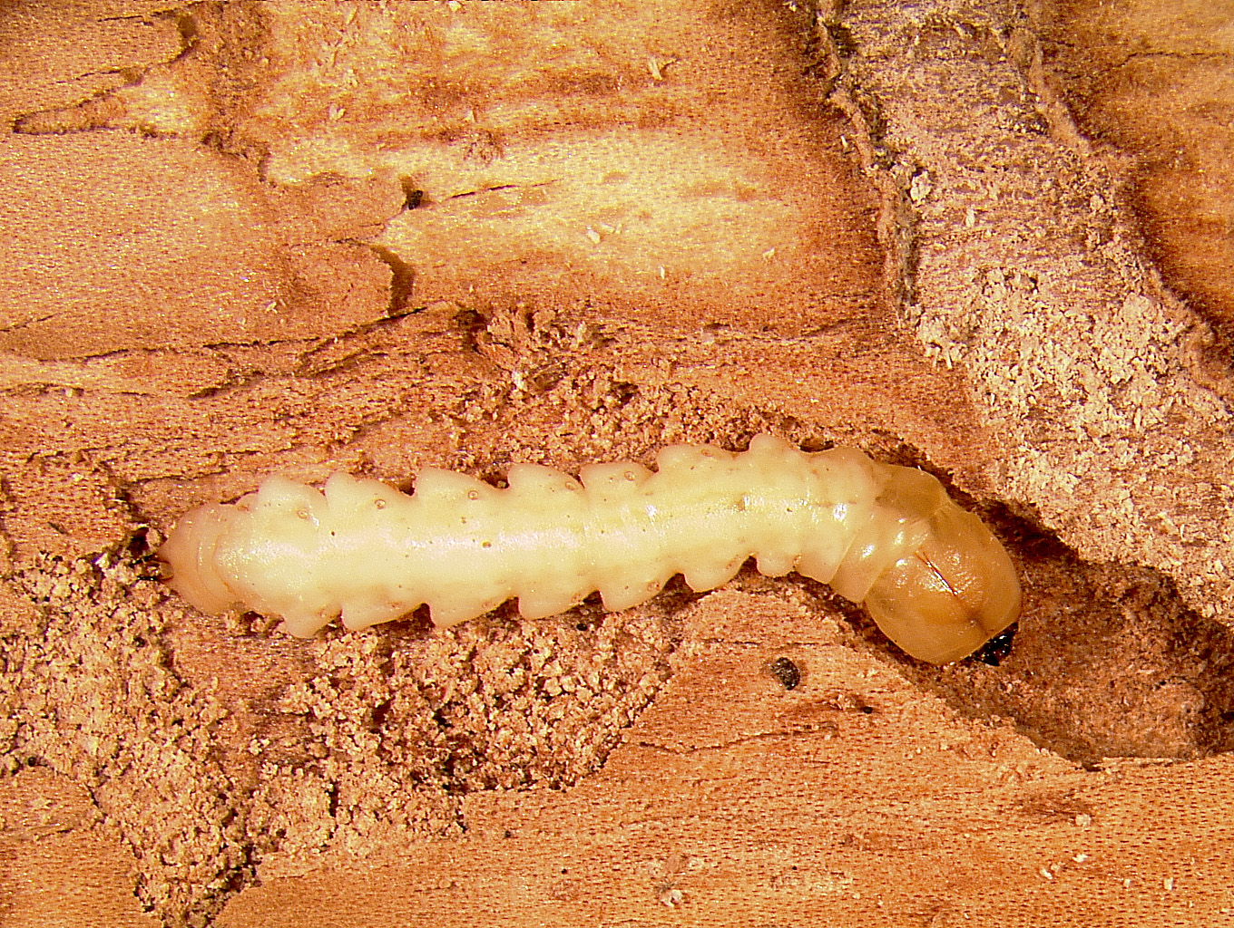
Predictions
If time has an effect on the detection of EABs, we would expect to see more detections of EABs in later years compared to earlier years.
Growing stages occur beneath the bark³
2-3 years to see damage³
HYPOTHESIS #1

Slide 5
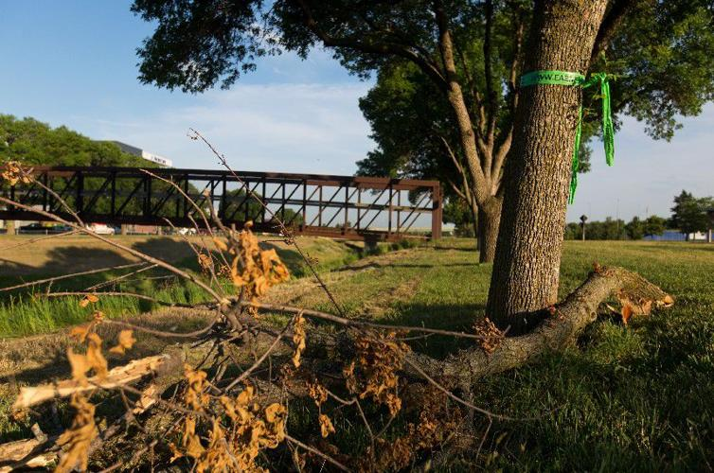
Predictions
If population density of Ontario communities impacts EAB detection, we would expect to see more detections in rural areas compared to urban communities
Higher population density & less green space = less resources and space for EABs to invade
HYPOTHESIS #2

Slide 6
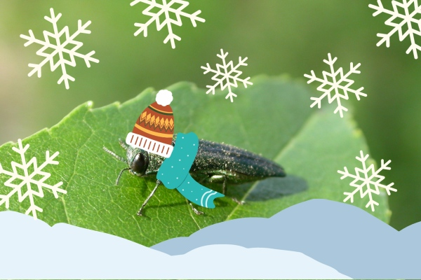
Predictions
If temperature drives the detection of emerald ash borers in various communities of Ontario, we would expect to see more EAB detections in communities with higher annual temperatures.
Warmer temperatures = more reproduction, development, and survival
HYPOTHESIS #3

Slide 7
METHODS
METHODS

Slide 8
DATA MANIPULATION
Emerald Ash Borer (Agrilus planipennis)’
Surveillance Data 2002 to 2020
Census Data derived from Stats Canada
Historical Weather Data
OUR FINAL DATA SET
Notes:
Urban areas are those continuously built-up areas having a minimum population concentration of 1,000 persons and a population density of at least 400 persons per square kilometer based on the previous census.”

Slide 9
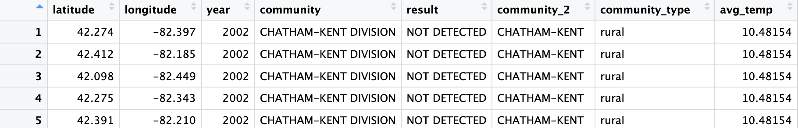
OUR DATA SET
Independent:
Years sampled: 2002 to 2020
(Ontario) Community: 154
Community Type: Rural or Urban
Average Annual Temperature: ˚C
Dependent:
Result: Detected or Not Detected
Notes:
Urban areas are those continuously built-up areas having a minimum population concentration of 1,000 persons and a population density of at least 400 persons per square kilometer based on the previous census.”

Slide 10
Hypothesis #1: Time impacts the detection of emerald ash borers in various Ontario communities.

Slide 11
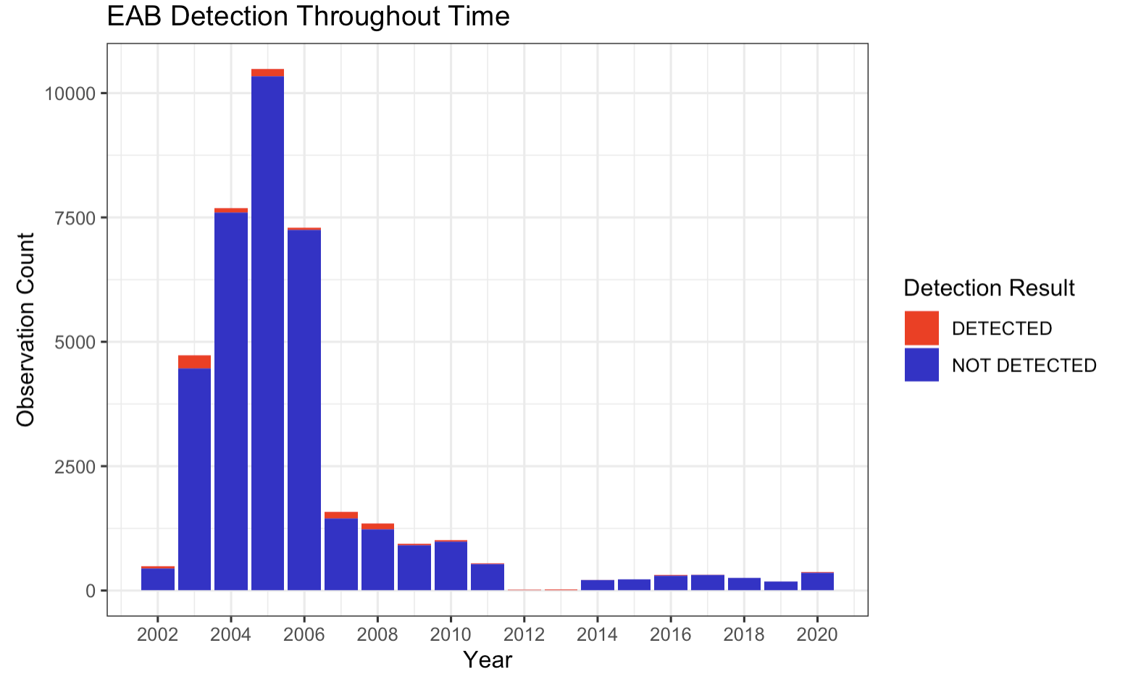
Hypothesis #1:
Notes:
As you can see, the observations are skewed through the years. The greatest number of observations happened between the years 2003 and 2010, which corresponds with some of the first recorded incidences of the EAB in North America. The most-important takeaway from this graph is the frequency of observations within this dataset changed significantly more over time than the detection of EABs did. Furthermore, this change in observation frequency over the years makes it harder to compare and contrast detection rate through the years.

Slide 12
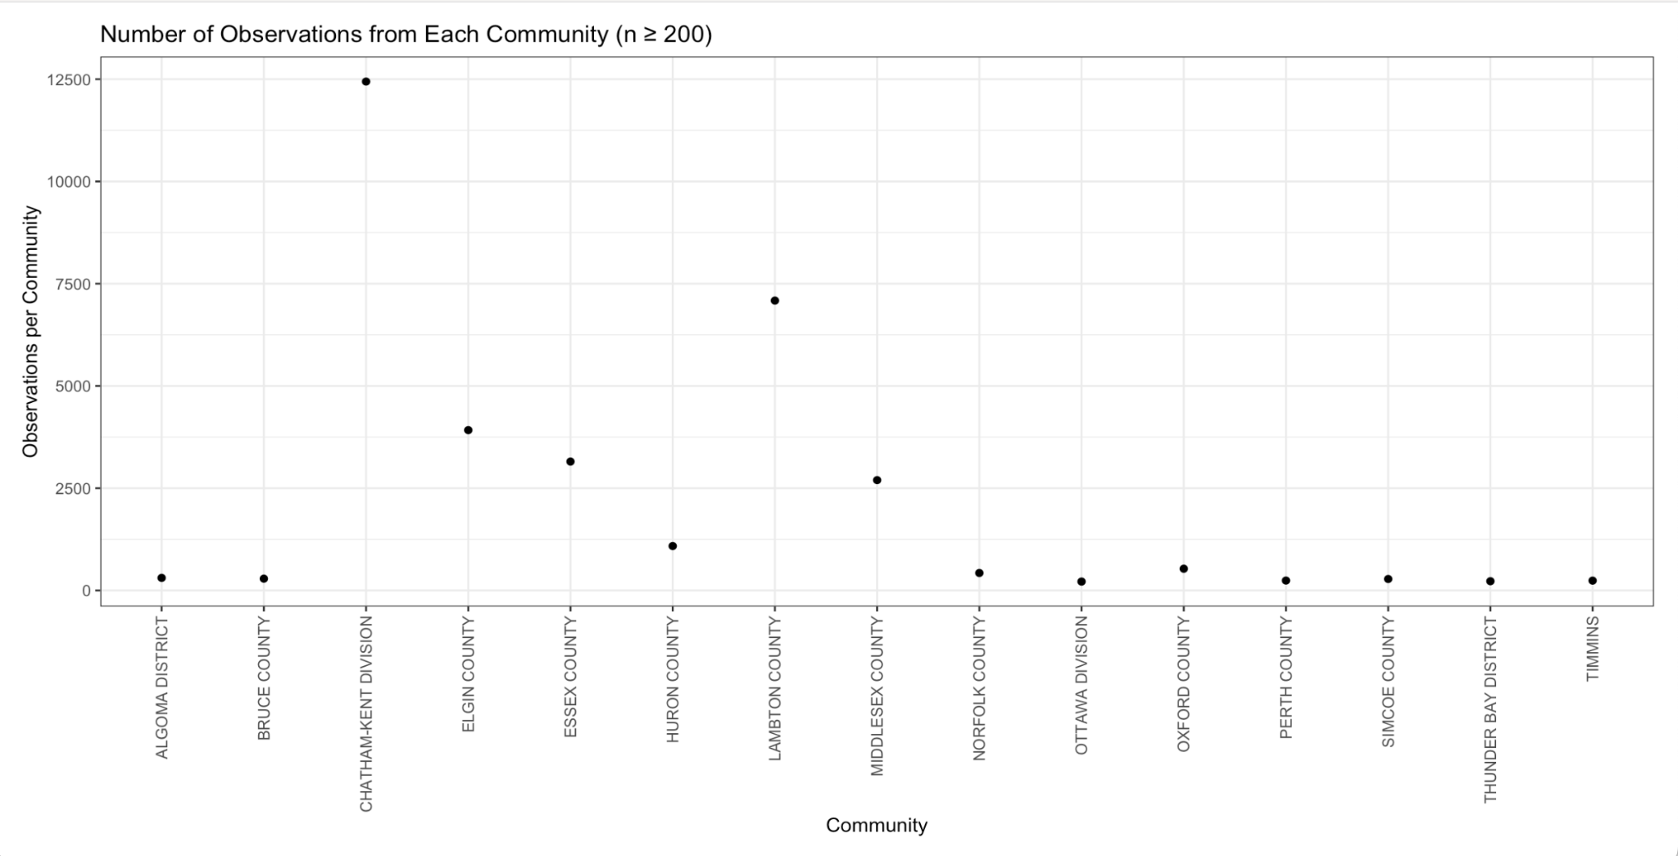
An Aside: What communities are driving the number of observations??
15 communities had ≥200 observations
Unequal observations led to skew
Some communities were very underrepresented
Chatham-Kent!!
Notes:
15 communities had 200+ observations (out of 154 communities total)
Some communities were only represented by 1 or 2 observations (across ALL years)!

Slide 13
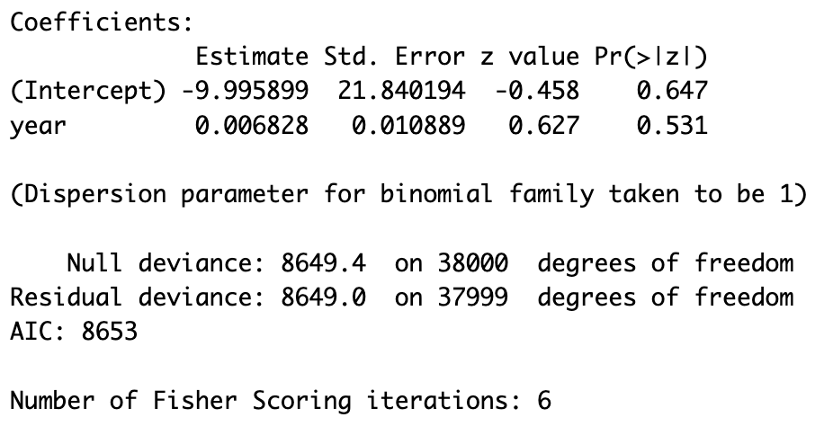
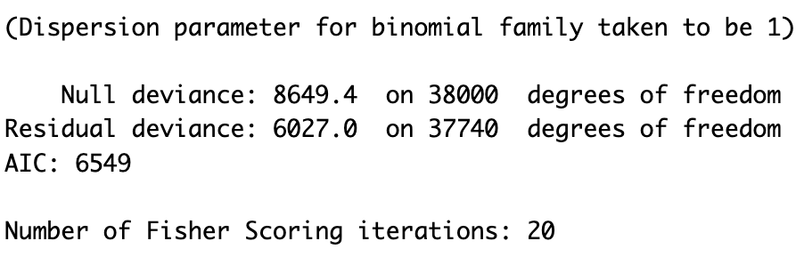
Hypothesis #1:
Is there an effect of time on EAB detection by community?
glm(as.factor(result)~year*community, family = binomial, data = ont_eab_data)
Is there an effect of time on EAB detection?
glm(as.factor(result)~year, family = binomial, data = ont_eab_data)
No Significant Coefficients
Notes:
In order to test the hypothesis of time on EAB detection, we first implemented a general linear model in r using result (presence/absence) and year. This however, came back inconclusive and showed no significant findings.
Next, we became more specific and tested whether time had an effect on EAB detection by community, this was done by including community as an interaction term in our previous model. We then ran an ANOVA, which tests for ____ and found two significant results.
First, community was significant with a p value of 0 and year:community was significant with a p-value of 0
Is there an effect of time on EAB detection by community?
glm(as.factor(result)~year*community, family = binomial, data = ont_eab_data)

Slide 14
Hypothesis #1 Results
Hypothesis 1: Detection of EAB through time
Recall Prediction: If time has an effect on the detection of EABs, we would expect to see more detections of EABs in later years compared to earlier years
Trend in data for earlier years
Fail to reject the null
Notes:
Hypothesis 1: Detection of EAB through time
Heavy sampling between the years 2003-2006, likely in response to initial detection in 2002
Chatham kent sampled _____ times during these years
Significant finding for community indicating that presence differs by locality for specific years, but year alone does not have a significant effect
Likely due to the decrease in observations

Slide 15
Hypothesis #2:
Population densities of Ontario communities impact EAB detection.
Notes:
Eva

Slide 16
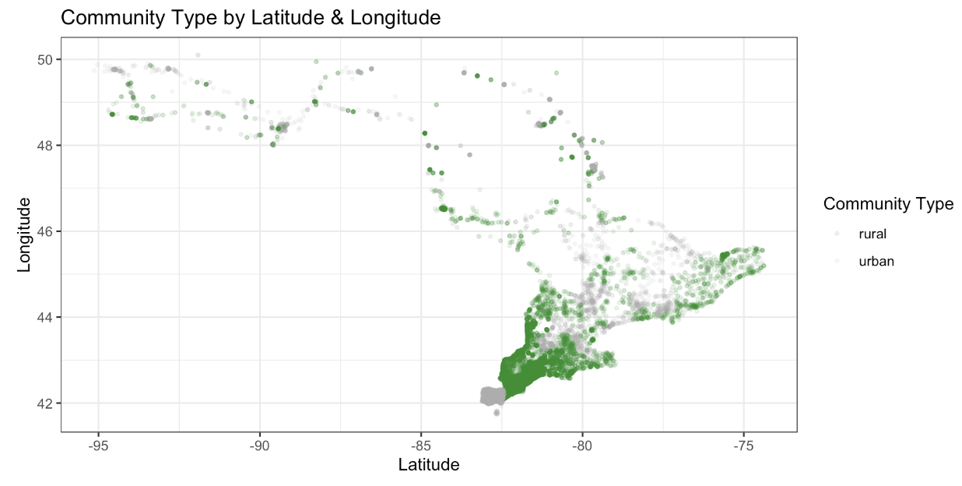
Latitude and longitude coordinates correlate with community type (rural or urban) in Ontario
Hypothesis #2:

Slide 17
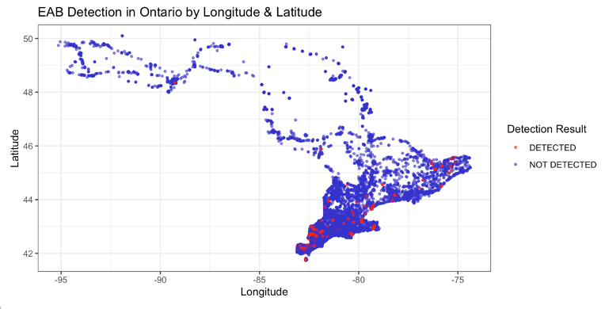
Hypothesis #2:
Notes:
We can see that the detections are primarily found in southern Ontario

Slide 18
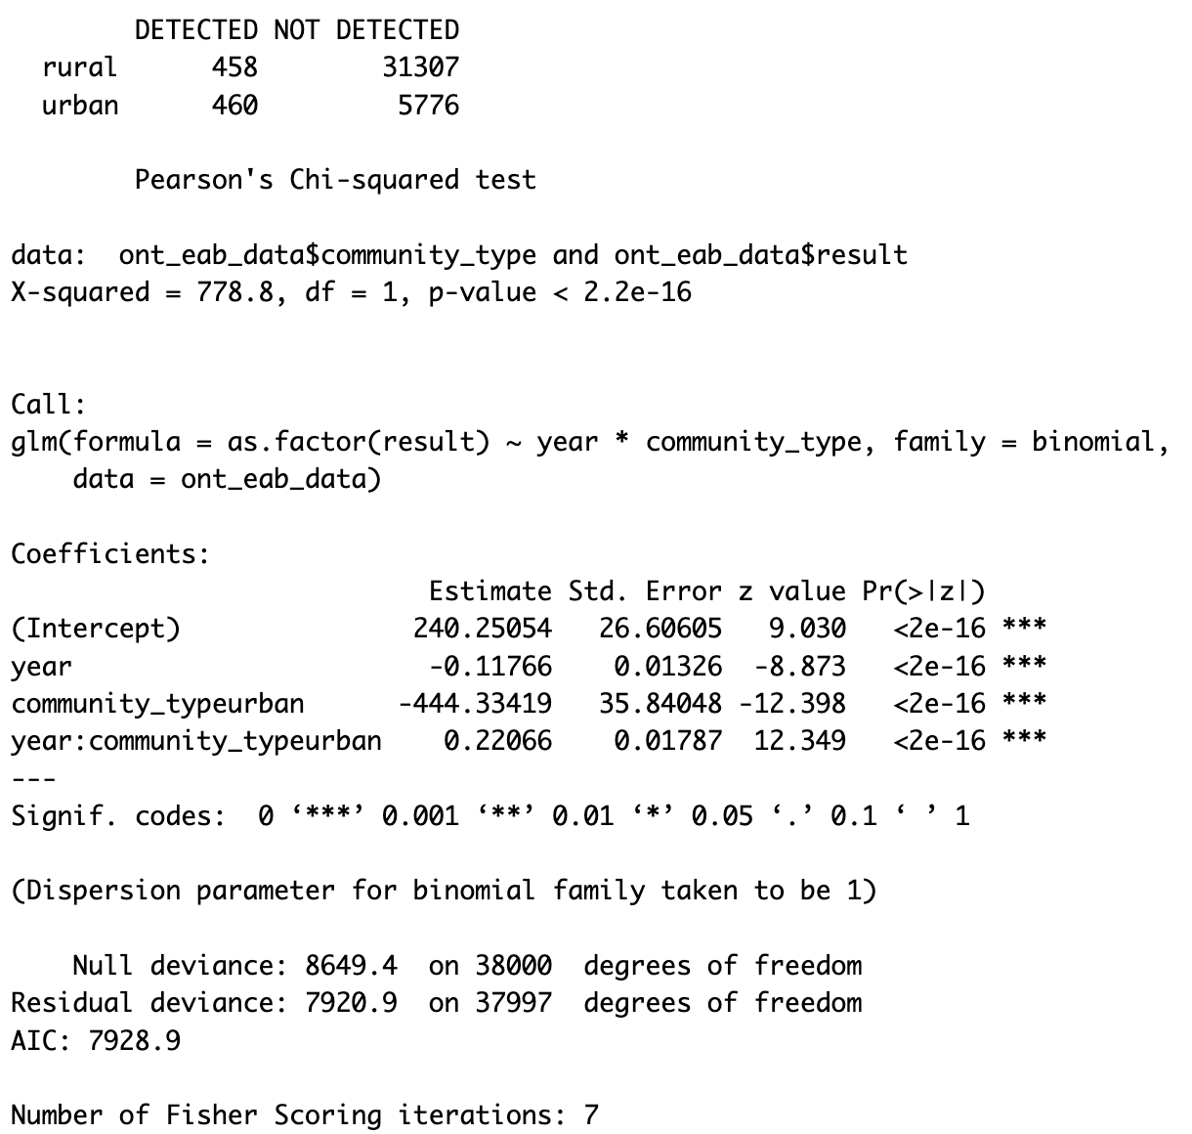
Model: community type on EAB detection
Hypothesis #2:
Out of 38,001 observations, 31,765 were from rural communities while only 6,236 were from urban communities
Notes:
Chi-squared test shows that

Slide 19
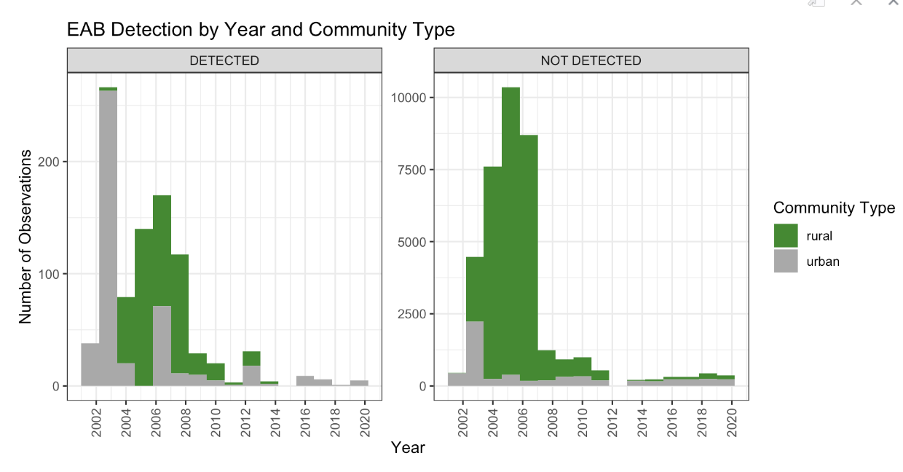
Hypothesis #2:
Notes:
Notice that the y-axis are different!!

Slide 20
Hypothesis #2 Results
Hypothesis 2: Detection of EAB based on Community Type
Recall Prediction: If population density of Ontario communities impacts EAB detection, we would expect to see more detections in rural areas compared to urban communities
We found that rural and urban communities had a similar amount of detections despite rural communities having more observations
Fail to reject the null
EAB Detection Rate
Rural Communities:
1.44%
Urban Communities: 7.38%
Notes:
jem

Slide 21
Hypothesis #3:
Temperature is a driver of EAB detection in various communities of Ontario.
Notes:
Jem
On to our third and final hypothesis, we wanted to see whether temperature had an impact in EAB detection in Ontario

Slide 22
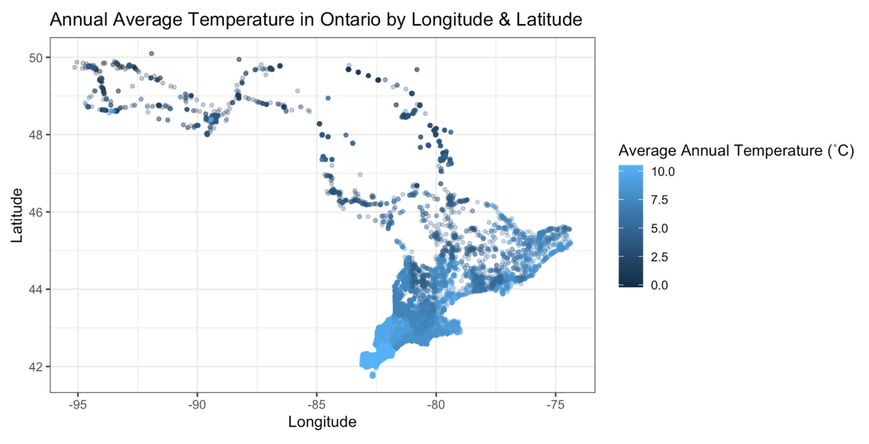
Hypothesis #3:
Red is Detected
Blue is Not Detected

Slide 23
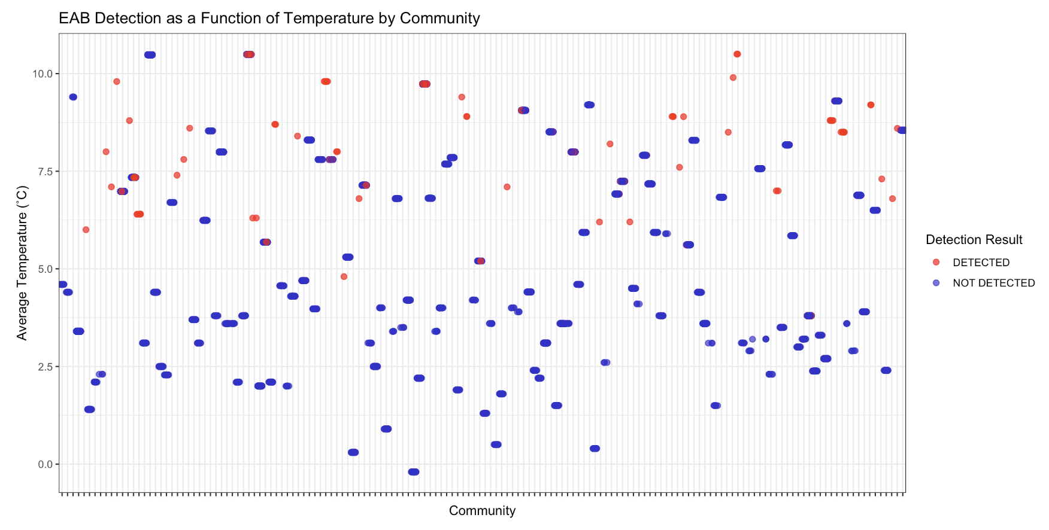
Hypothesis #3:
Notes:
Average annual temperature decreased over the years - less a statement about climate change and more an impact of where they focused their observations. Later years in the study focused on cooler communities in northern Ontario

Slide 24
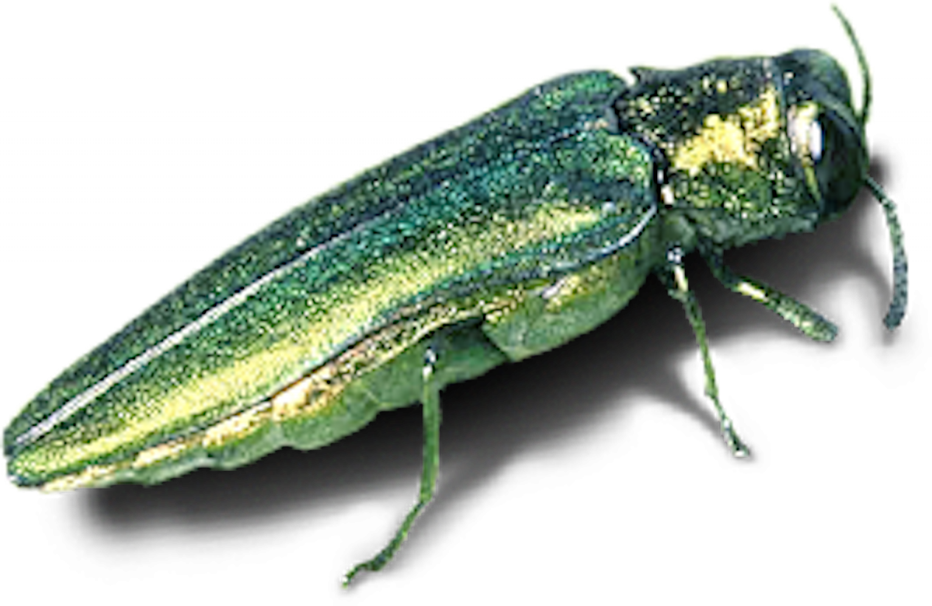
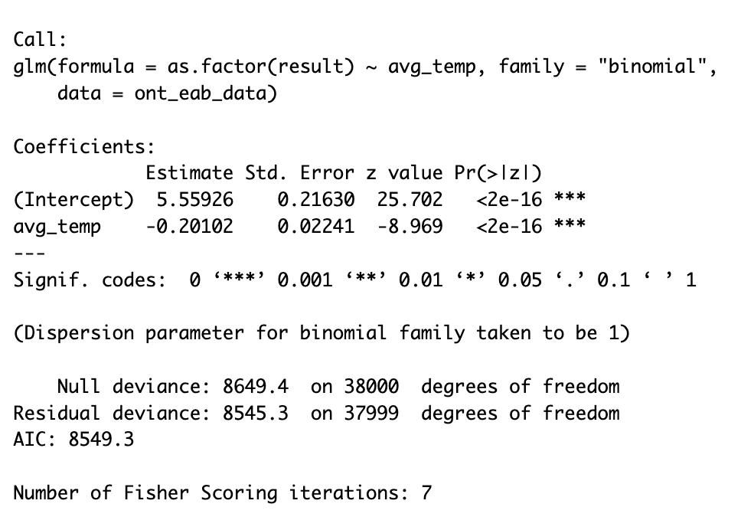
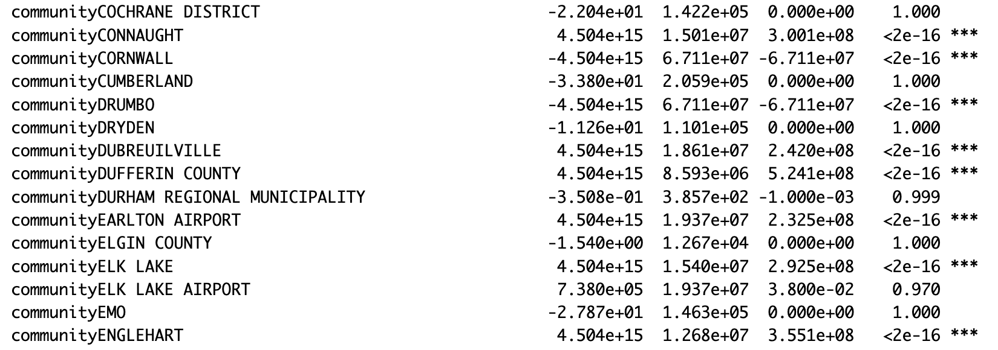
Hypothesis #3:
temp_model <- glm(as.factor(result) ~avg_temp, family = binomial, data = ont_eab_data)
temp_model <- glm(as.factor(result) ~avg_temp+community, family = binomial, data = ont_eab_data)
Notes:
As year increases, the likelihood of detection decreases
As average temp increase, the likelihood of detection decreases
This is likely due to

Slide 25
Hypothesis #3 Results
Hypothesis 3: Effect of Temperature on EAB Detection
Recall Prediction: If temperature drives the detection of emerald ash borers in various communities of Ontario, we would expect to see more EAB detections in communities with higher annual temperatures.
We found that EABs were more prevalent in communities with higher average annual temperatures
We reject the null hypothesis
BUT not all communities are significant
Notes:
jem

Slide 26
Conclusions
The effectiveness of current management and removal strategies
The impact of climate change on EAB populations
Indirectly affecting human health: Respiratory Issues⁵
Overall human impact and assistance in spread
Notes:
The effectiveness of current management and removal strategies
There are currently many policies in place to manage the spread of the EAB, therefore, by examining the detection of EAB in districts across Ontario, one can determine if procedures such as insecticide treatments and quarantining infected wood products help keep EAB populations within one district or allow spread into nearby communities. EAB can use other tree species as a host while looking for ash trees including Elm and Walnut.
The impact of climate change on EAB populations
By examining variables such as temperature, there is potential in our study to examine future climate scenarios by incorporating climate data and seeing if rising temperatures and climate change can increase the breeding season and detection of the EAB.
Overall human impact and assistance in spread
We understand that EAB primarily spreads with human assistance through the transport of infected wood products. Our study could help analyze patterns of human movement, population density, and wood trade to see if they influence the spread of the EAB. If these movement dynamics are influenced by human activity, it can be informative in developing new targeted interventions and regulation to control the EAB spread.
Respiratory Issues: Ash trees contribute to natural cooling, stormwater capture, reducing airborne pollutants which leads to reduced incidence of cardiovascular disease and asthma, faster recovery from surgery, and improved air quality. As they die off, and EAB move onto new victims, there can be an increase in resporatoy illness and infectious disease as the environment lose vital trees.

Slide 27
References
Johny S, Kyei-Poku G, Gauthier D, van Frankenhuyzen K, Krell PJ. 2o12. Characterization and virulence of Beauveria spp. recovered from emerald ash borer in southwestern Ontario, Canada. J Invertebr Pathol 111(1): 41-49.
Eckenwalder JE, Metsger DA, Dickinson TA, Hodges SH. 2023. A Field Guide to Trees of Ontario. Royal Ontario Museum.
Ryall, K. L., Fidgen, J. G., &amp; Turgeon, J. J. (2011). Detectability of the emerald ash borer (Coleoptera: Buprestidae) in asymptomatic urban trees by using branch samples. Environmental Entomology, 40(3), 679–688.
Donovan, G. H., Butry, D. T., Michael, Y. L., Prestemon, J. P., Liebhold, A. M., Gatziolis, D., &amp; Mao, M. Y. (2013). The relationship between trees and human health. American Journal of Preventive Medicine, 44(2), 139–145.
Government of Canada. 2017b. CFIA Observations of EAB: Government of Canada, Emerald Ash Borer Surveillance Data 2002-2020, Canadian Food Inspection Agency. [online] https://open.canada.ca/ data/en/dataset/69f4ecd8-9761-4d40-b0f9-e186f2fcce5b. [accessed 1 October 2023].

Slide 28
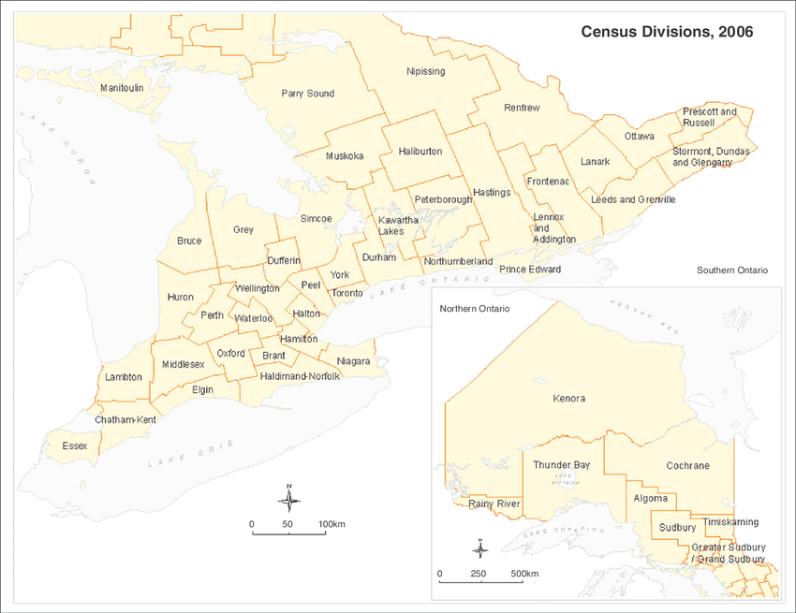
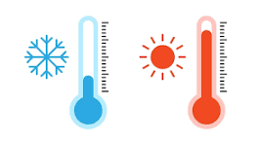



DATA MANIPULATION
Emerald Ash Borer
Surveillance Data 2002 to 2020
EAB SURVEILLANCE DATA CONTENTS:
Lat long
Survey
Year
Province -> Ontario
Community
Result
EAB SURVEILLANCE DATA CONTENTS:
Lat long
Survey
Year
Province
Community
Result
Census Data derived from Stats Canada
Historical Weather Data
OUR FINAL DATA SET

Slide 29
Breakdown of some of the communities from our dataset!

Slide 30
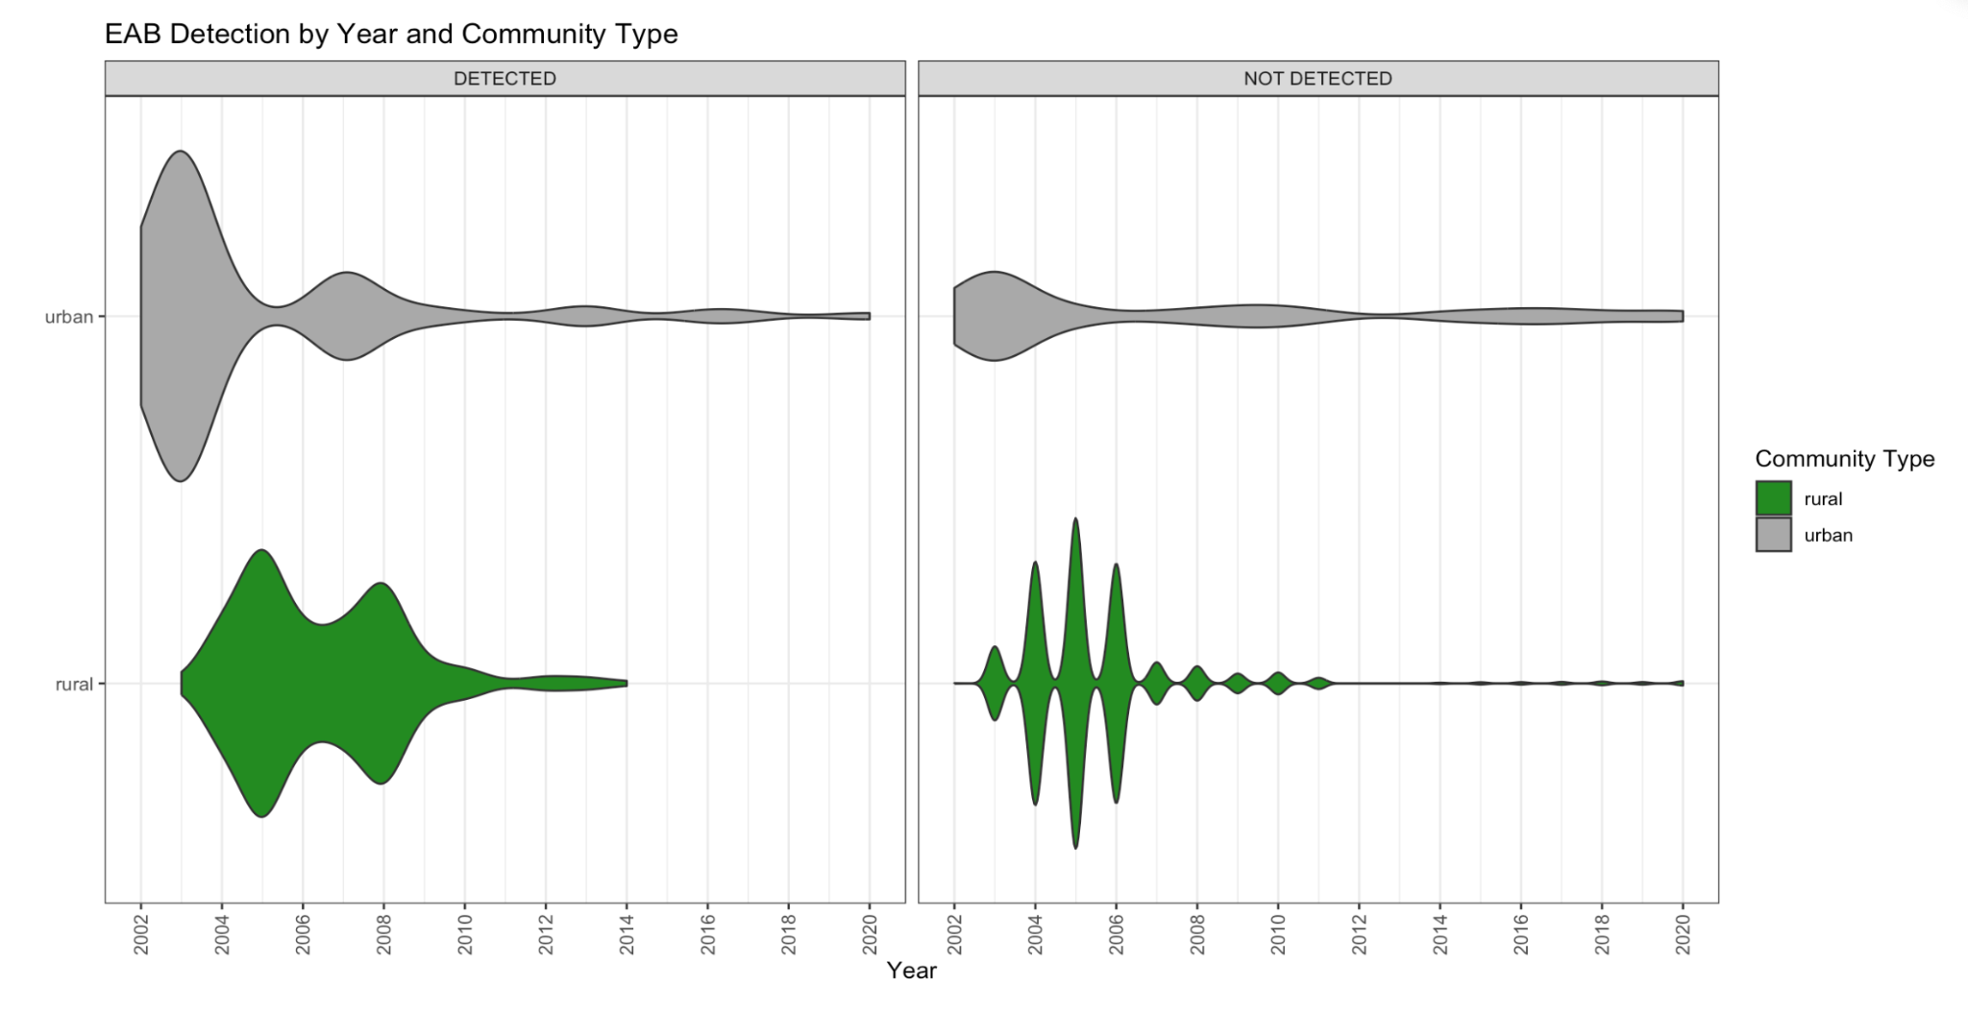
Hypothesis #2:

Slide 31
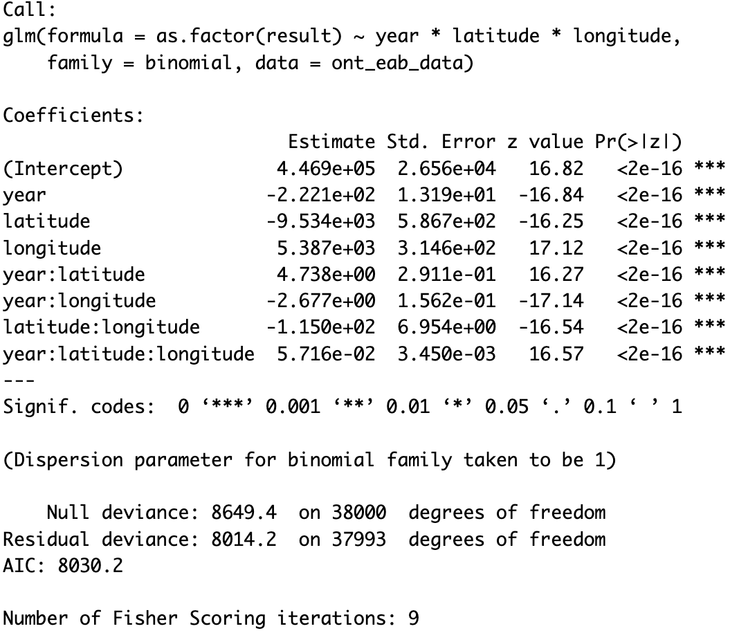
Hypothesis #2:
Differences in population densities of rural and urban Ontario communities impact the detection of EAB over the years.
Latitude and longitude coordinates correlate with community type (rural or urban) in Ontario
Notes:
Detection less likely at higher latitudes (northwards)
Detection more likely at higher longitude (eastwards)
In later years, detection increased at higher lat (rural communities started being sampled as well)
At higher lat and long detection is less likely
At higher lat and long in later years, detection increases as sampling increases

